Slide 1
GIT HUB
Lokesh

Slide 2
Github.com to create your account

Slide 3
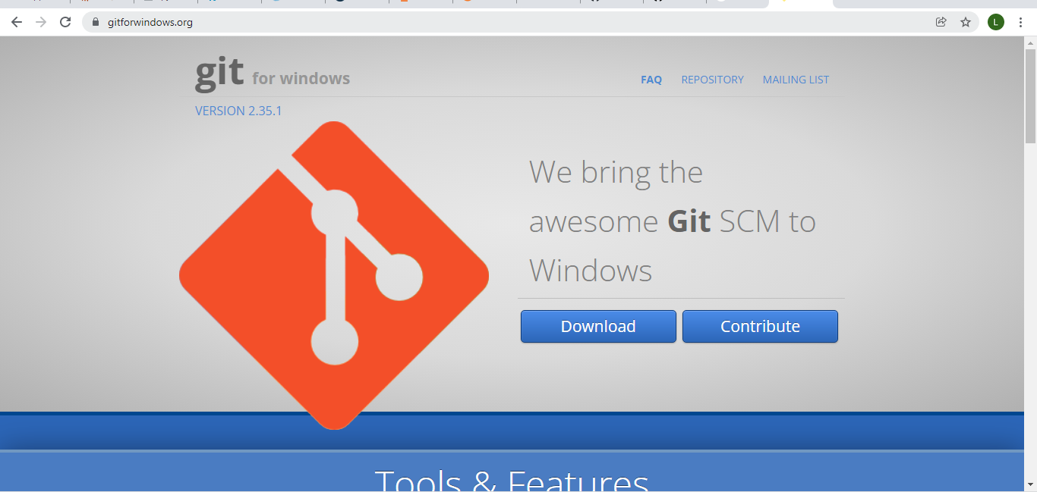
Install git

Slide 4
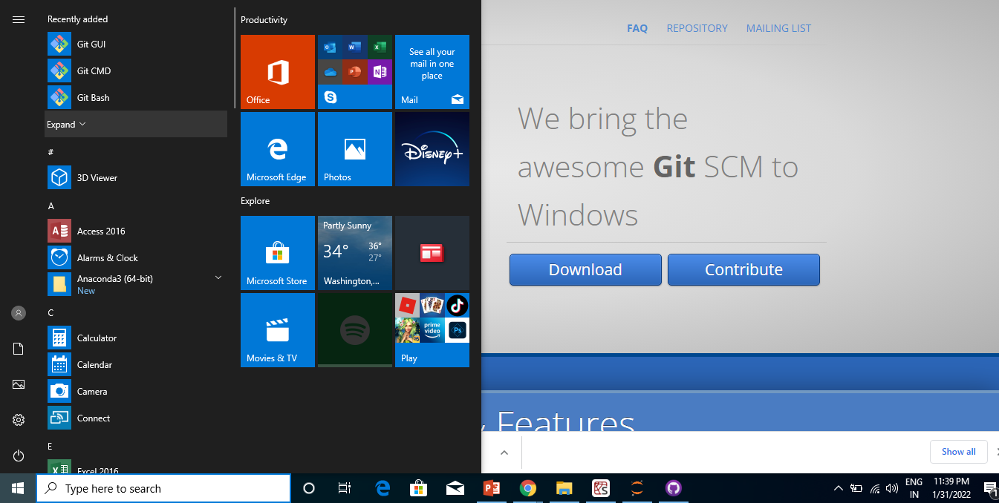
Open CMD or Bash

Slide 5
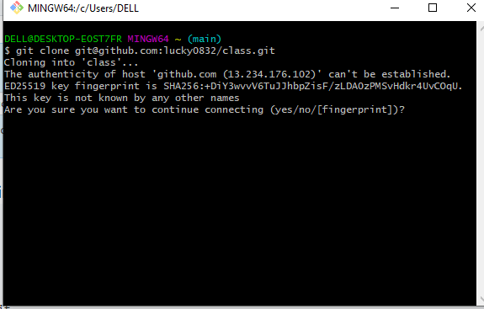
Cloning Remote Repo
git clone <Remote Repo URL>

Slide 6
Create Repo
echo "# class" >> README.md
git init
git add README.md

Slide 7
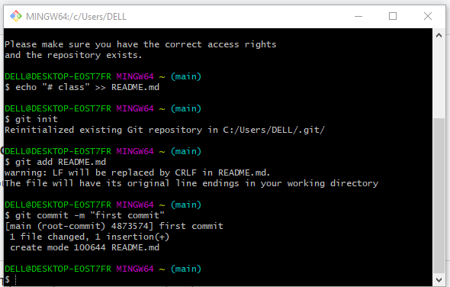

Slide 8
Create Repo…
git commit -m "first commit"
git branch -M main
git remote add origin git@github.com:lucky0832/class.git
git push -u origin main

Slide 9
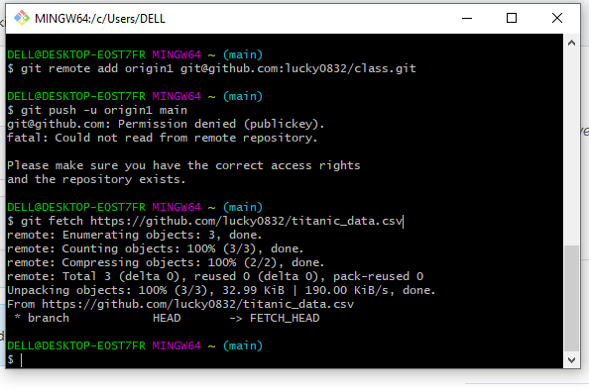
git fetch remote

Slide 10
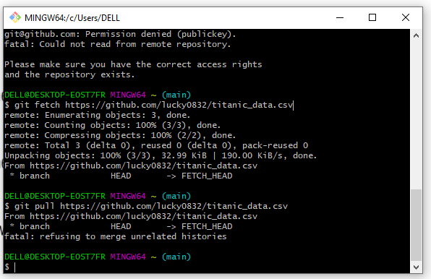
git pull

Slide 11
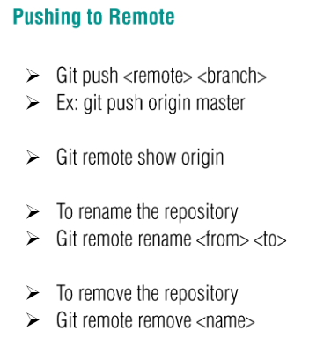

Slide 12
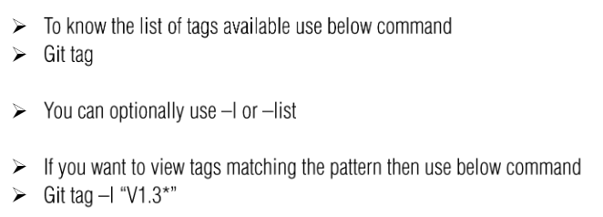
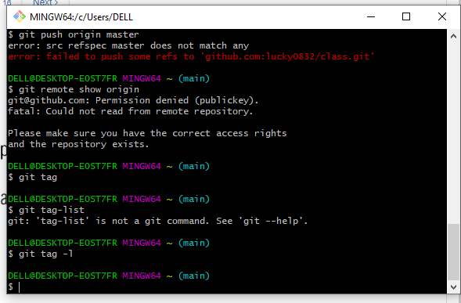
tagging

Slide 13
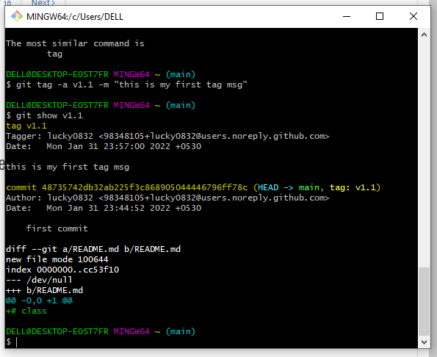
Creating Tag

Slide 14
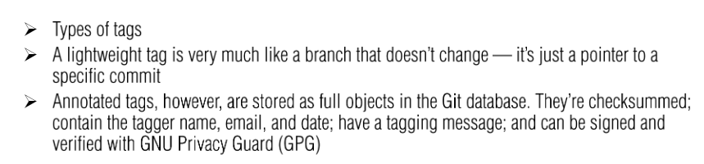
Creating tag

Slide 15
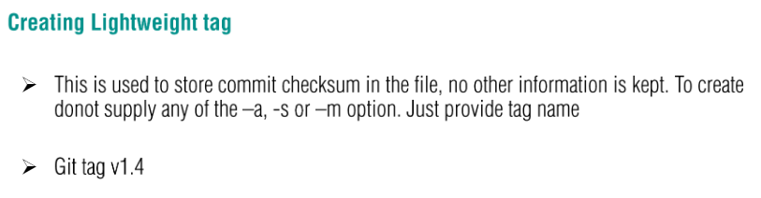
Light weight tag

Slide 16
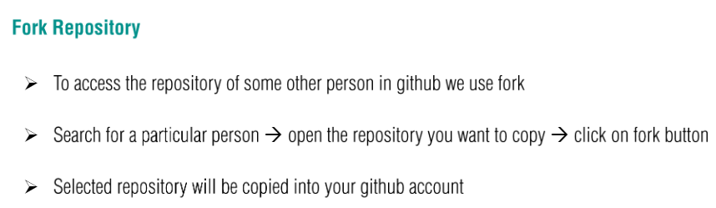
Fork

Slide 17
